Slide 1
بسم الله الرحمن الرحیم

Slide 2
CS101 Introduction to Computer Science

Slide 3
Lecture 15

Slide 4
data structures
Notes:
may seem arcane but lots of data structures in world

Slide 5
abstract data types

Slide 6
queues
Notes:
- waiting in line
- 3 volunteers

Slide 7
FIFO

Slide 8
enqueue
dequeue

Slide 9
const int CAPACITY = 50;
typedef struct
{
person people[CAPACITY];
int size;
} queue;

Slide 10
stacks
Notes:
- stack of sweaters
- Gmail inbox
- 3 volunteers

Slide 11
LIFO

Slide 12
push
pop

Slide 13
const int CAPACITY = 50;
typedef struct
{
person people[CAPACITY];
int size;
} stack;

Slide 14
arrays

Slide 16
 | 1 | 2 | 3

Slide 17
 | 1 | 2 | 3

Slide 18
 | 1 | 2 | 3

Slide 19

 | 1 | 2 | 3 | h | e | l | l
o | , |  | w | o | r | l | d
\0

Slide 20
 | 1 | 2 | 3

Slide 21
 | 1 | 2 | 3
 | 1

Slide 22
 | 1 | 2 | 3
 | 1 | 2

Slide 23
 | 1 | 2 | 3
 | 1 | 2 | 3

Slide 24
 | 1 | 2 | 3
 | 1 | 2 | 3 | 4

Slide 25
 | 1 | 2 | 3 | 4
Notes:
list{0,1,2}.c

Slide 26
data structures

Slide 27
struct
.
*

Slide 28
struct
->

Slide 29
linked lists

Slide 31
 |  | 1 0x123

Slide 32
 |  | 1 0x123
 |  |  |  | 2 0x456

Slide 33
 |  | 1 0x123
 |  |  |  | 2 0x456
 |  |  |  |  |  | 3 0x789

Slide 34
 |  | 1 0x123
 |  |  |  | 2 0x456
 |  |  |  |  |  | 3 0x789

Slide 35
 |  | 1 0x123
 |  | 0x456 |  | 2 0x456
 |  |  |  |  |  | 3 0x789

Slide 36
 |  | 1 0x123
 |  | 0x456 |  | 2 0x456
 |  |  |  | 0x789 |  | 3 0x789

Slide 37
 |  | 1 0x123
 |  | 0x456 |  | 2 0x456
 |  |  |  | 0x789 |  | 3 0x789
 |  |  |  |  |  | 0x0

Slide 38
 |  | 1 0x123
 |  | 0x456 |  | 2 0x456
 |  |  |  | 0x789 |  | 3 0x789
 |  |  |  |  |  | NULL

Slide 39
 |  | 1 0x123
 |  | 0x456 |  | 2 0x456
0x123 |  |  |  | 0x789 |  | 3 0x789
 |  |  |  |  |  | NULL

Slide 40
 |  | 1
 |  |  |  | 2
 |  |  |  |  |  | 3

Slide 41
typedef struct
{
string name;
string number;
} person;

Slide 42
typedef struct
{
char *name;
char *number;
} person;

Slide 43
typedef struct
{
} person;

Slide 44
typedef struct
{
} node;

Slide 45
typedef struct
{
int number;
} node;

Slide 46
typedef struct
{
int number;
node *next;
} node;

Slide 47
typedef struct node
{
int number;
node *next;
} node;

Slide 48
typedef struct node
{
int number;
struct node *next;
} node;
Notes:
list3.c (to show prepending)

Slide 50
node *list;

Slide 51
node *list;
list

Slide 52
node *list = NULL;
list

Slide 53
node *list = NULL;
list

Slide 54
node *n = malloc(sizeof(node));
list

Slide 55
node *n = malloc(sizeof(node));
list
n

Slide 56
node *n = malloc(sizeof(node));
list
number
n
next

Slide 57
node *n = malloc(sizeof(node));
list
number
n
next

Slide 58
(*n).number = 1;
list
number
n
next

Slide 59
(*n).number = 1;
list
1
number
n
next

Slide 60
n->number = 1;
list
1
number
n
next

Slide 61
n->next = NULL;
list
1
number
n
next

Slide 62
n->next = NULL;
list
1
number
n
next

Slide 63
list = n;
list
1
number
n
next

Slide 64
list = n;
list
1
number
n
next

Slide 65
list
1

Slide 66
node *n = malloc(sizeof(node));
list
1

Slide 67
node *n = malloc(sizeof(node));
list
1
n

Slide 68
node *n = malloc(sizeof(node));
list
1
n

Slide 69
node *n = malloc(sizeof(node));
list
1
n

Slide 70
n->number = 2;
list
1
n

Slide 71
n->number = 2;
list
2
1
n

Slide 72
n->next = NULL;
list
2
1
n

Slide 73
n->next = NULL;
list
2
1
n

Slide 74
list
2
1
n

Slide 75
list = n;
list
2
1
n

Slide 76
list = n;
list
2
1
n

Slide 77
list = n;
list
2
1
n

Slide 78
list
2
1
n

Slide 79
n->next = list;
list
2
1
n

Slide 80
n->next = list;
list
2
1
n

Slide 81
list = n;
list
2
1
n

Slide 82
list = n;
list
2
1
n

Slide 83
list
2
1

Slide 84
list
2
1
3
Notes:
list4.c (to show printing with while loop)

Slide 85
ptr
list
2
1
3

Slide 86
ptr
list
2
1
3

Slide 87
ptr
list
2
1
3

Slide 88
ptr
list
2
1
3

Slide 89
list
2
1
3
Notes:
list5.c (for loop instead)

Slide 90
O(n²)
O(n log n)
O(n)
O(log n)
O(1)

Slide 91
list

Slide 92
list
1

Slide 93
list
2
1

Slide 94
list
2
1
3

Slide 95
O(n²)
O(n log n)
O(n)
O(log n)
O(1)

Slide 96
O(n²)
O(n log n)
O(n)
O(log n)
O(1)
Notes:
list6.c (freeing, after showing valgrind on list5)

Slide 97
O(n²)
O(n log n)
O(n) search
O(log n)
O(1) insertion

Slide 98
O(n²)
O(n log n)
O(n) search, deletion
O(log n)
O(1) insertion

Slide 99
list

Slide 100
list
1

Slide 101
2
list
1

Slide 102
2
list
1
3

Slide 103
O(n²)
O(n log n)
O(n)
O(log n)
O(1)
Notes:
list7.c (append)

Slide 104
O(n²)
O(n log n)
O(n) search, deletion, insertion
O(log n)
O(1)

Slide 105
list

Slide 106
list
2

Slide 107
list
2
1

Slide 108
4
list
2
1

Slide 109
4
list
2
3
1

Slide 110
O(n²)
O(n log n)
O(n)
O(log n)
O(1)
Notes:
list8.c (sorted)

Slide 111
O(n²)
O(n log n)
O(n) search, deletion, insertion
O(log n)
O(1)
Notes:
list8.c (sorted)

Slide 112

Notes:
https://emojipedia.org/apple/ios-17.4/jack-o-lantern

Slide 113
trees

Slide 114
binary search trees

Slide 115
 | 1 | 2 | 3 | 4 | 5 | 6 | 7

Slide 116
 | 1 | 2 | 3 | 4 | 5 | 6 | 7

Slide 117
 | 1 | 2 | 3 | 4 | 5 | 6 | 7

Slide 118
 | 1 | 2 | 3 | 4 | 5 | 6 | 7

Slide 119
4
2
6
1
3
5
7

Slide 120
4
2
6
1
3
5
7
Notes:
each square is an abstraction of a node now, no need to keep drawing rects

Slide 121
typedef struct node
{
int number;
struct node *next;
} node;

Slide 122
typedef struct node
{
int number;
} node;

Slide 123
typedef struct node
{
int number;
} node;

Slide 124
typedef struct node
{
int number;
struct node *left;
struct node *right;
} node;

Slide 125
4
2
6
1
3
5
7

Slide 126
bool search(node *tree, int number)
{
if (tree == NULL)
{
return false;
}
else if (number < tree->number)
{
return search(tree->left, number);
}
else if (number > tree->number)
{
return search(tree->right, number);
}
else if (number == tree->number)
{
return true;
}
}

Slide 127
bool search(node *tree, int number)
{
if (tree == NULL)
{
return false;
}
else if (number < tree->number)
{
return search(tree->left, number);
}
else if (number > tree->number)
{
return search(tree->right, number);
}
else if (number == tree->number)
{
return true;
}
}

Slide 128
bool search(node *tree, int number)
{
if (tree == NULL)
{
return false;
}
else if (number < tree->number)
{
return search(tree->left, number);
}
else if (number > tree->number)
{
return search(tree->right, number);
}
else if (number == tree->number)
{
return true;
}
}

Slide 129
bool search(node *tree, int number)
{
if (tree == NULL)
{
return false;
}
else if (number < tree->number)
{
return search(tree->left, number);
}
else if (number > tree->number)
{
return search(tree->right, number);
}
else if (number == tree->number)
{
return true;
}
}

Slide 130
bool search(node *tree, int number)
{
if (tree == NULL)
{
return false;
}
else if (number < tree->number)
{
return search(tree->left, number);
}
else if (number > tree->number)
{
return search(tree->right, number);
}
else if (number == tree->number)
{
return true;
}
}

Slide 131
bool search(node *tree, int number)
{
if (tree == NULL)
{
return false;
}
else if (number < tree->number)
{
return search(tree->left, number);
}
else if (number > tree->number)
{
return search(tree->right, number);
}
else if (number == tree->number)
{
return true;
}
}

Slide 132
4
2
6
1
3
5
7

Slide 133
Notes:
What if we build a BST from scratch, starting with 2?

Slide 134
2

Slide 135
2
1
Notes:
then 1

Slide 136
2
1
3
Notes:
then 3. looks fine.

Slide 137
Notes:
what if the insertion order is 1-2-3 instead?

Slide 138
1

Slide 139
1
2

Slide 140
1
2
3

Slide 141
O(n²)
O(n log n)
O(n)
O(log n)
O(1)

Slide 142
dictionaries

Slide 144
word | definition

Slide 145
key | value

Slide 146

Notes:
https://apps.apple.com/us/app/contacts/id1069512615#?platform=iphone

Slide 147
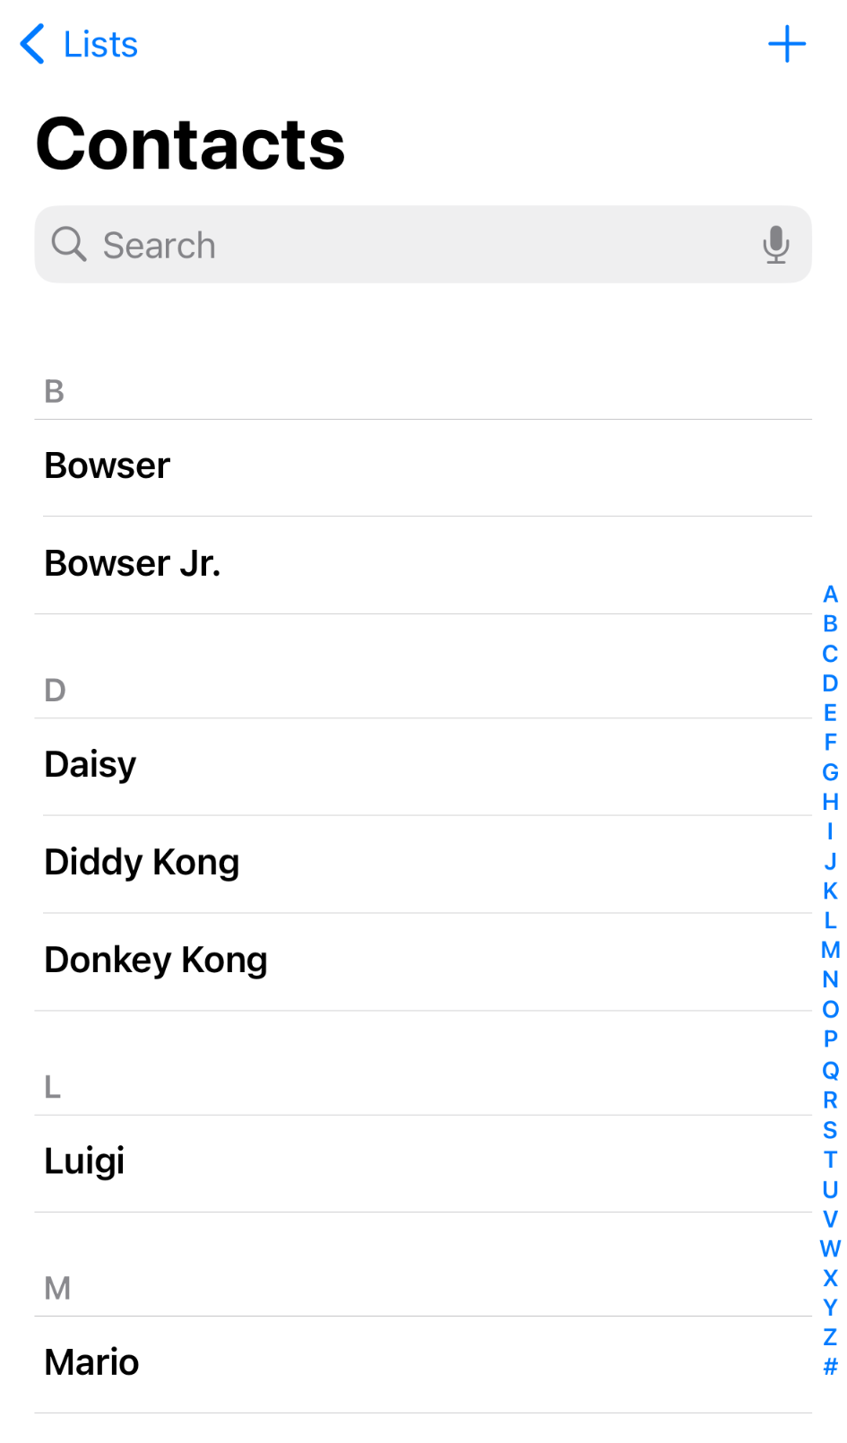
Notes:
https://nintendo.fandom.com/wiki/Nintendo_characters#Mario_series_(including_sub-franchises)

Slide 148


Slide 149
name | number

Slide 150
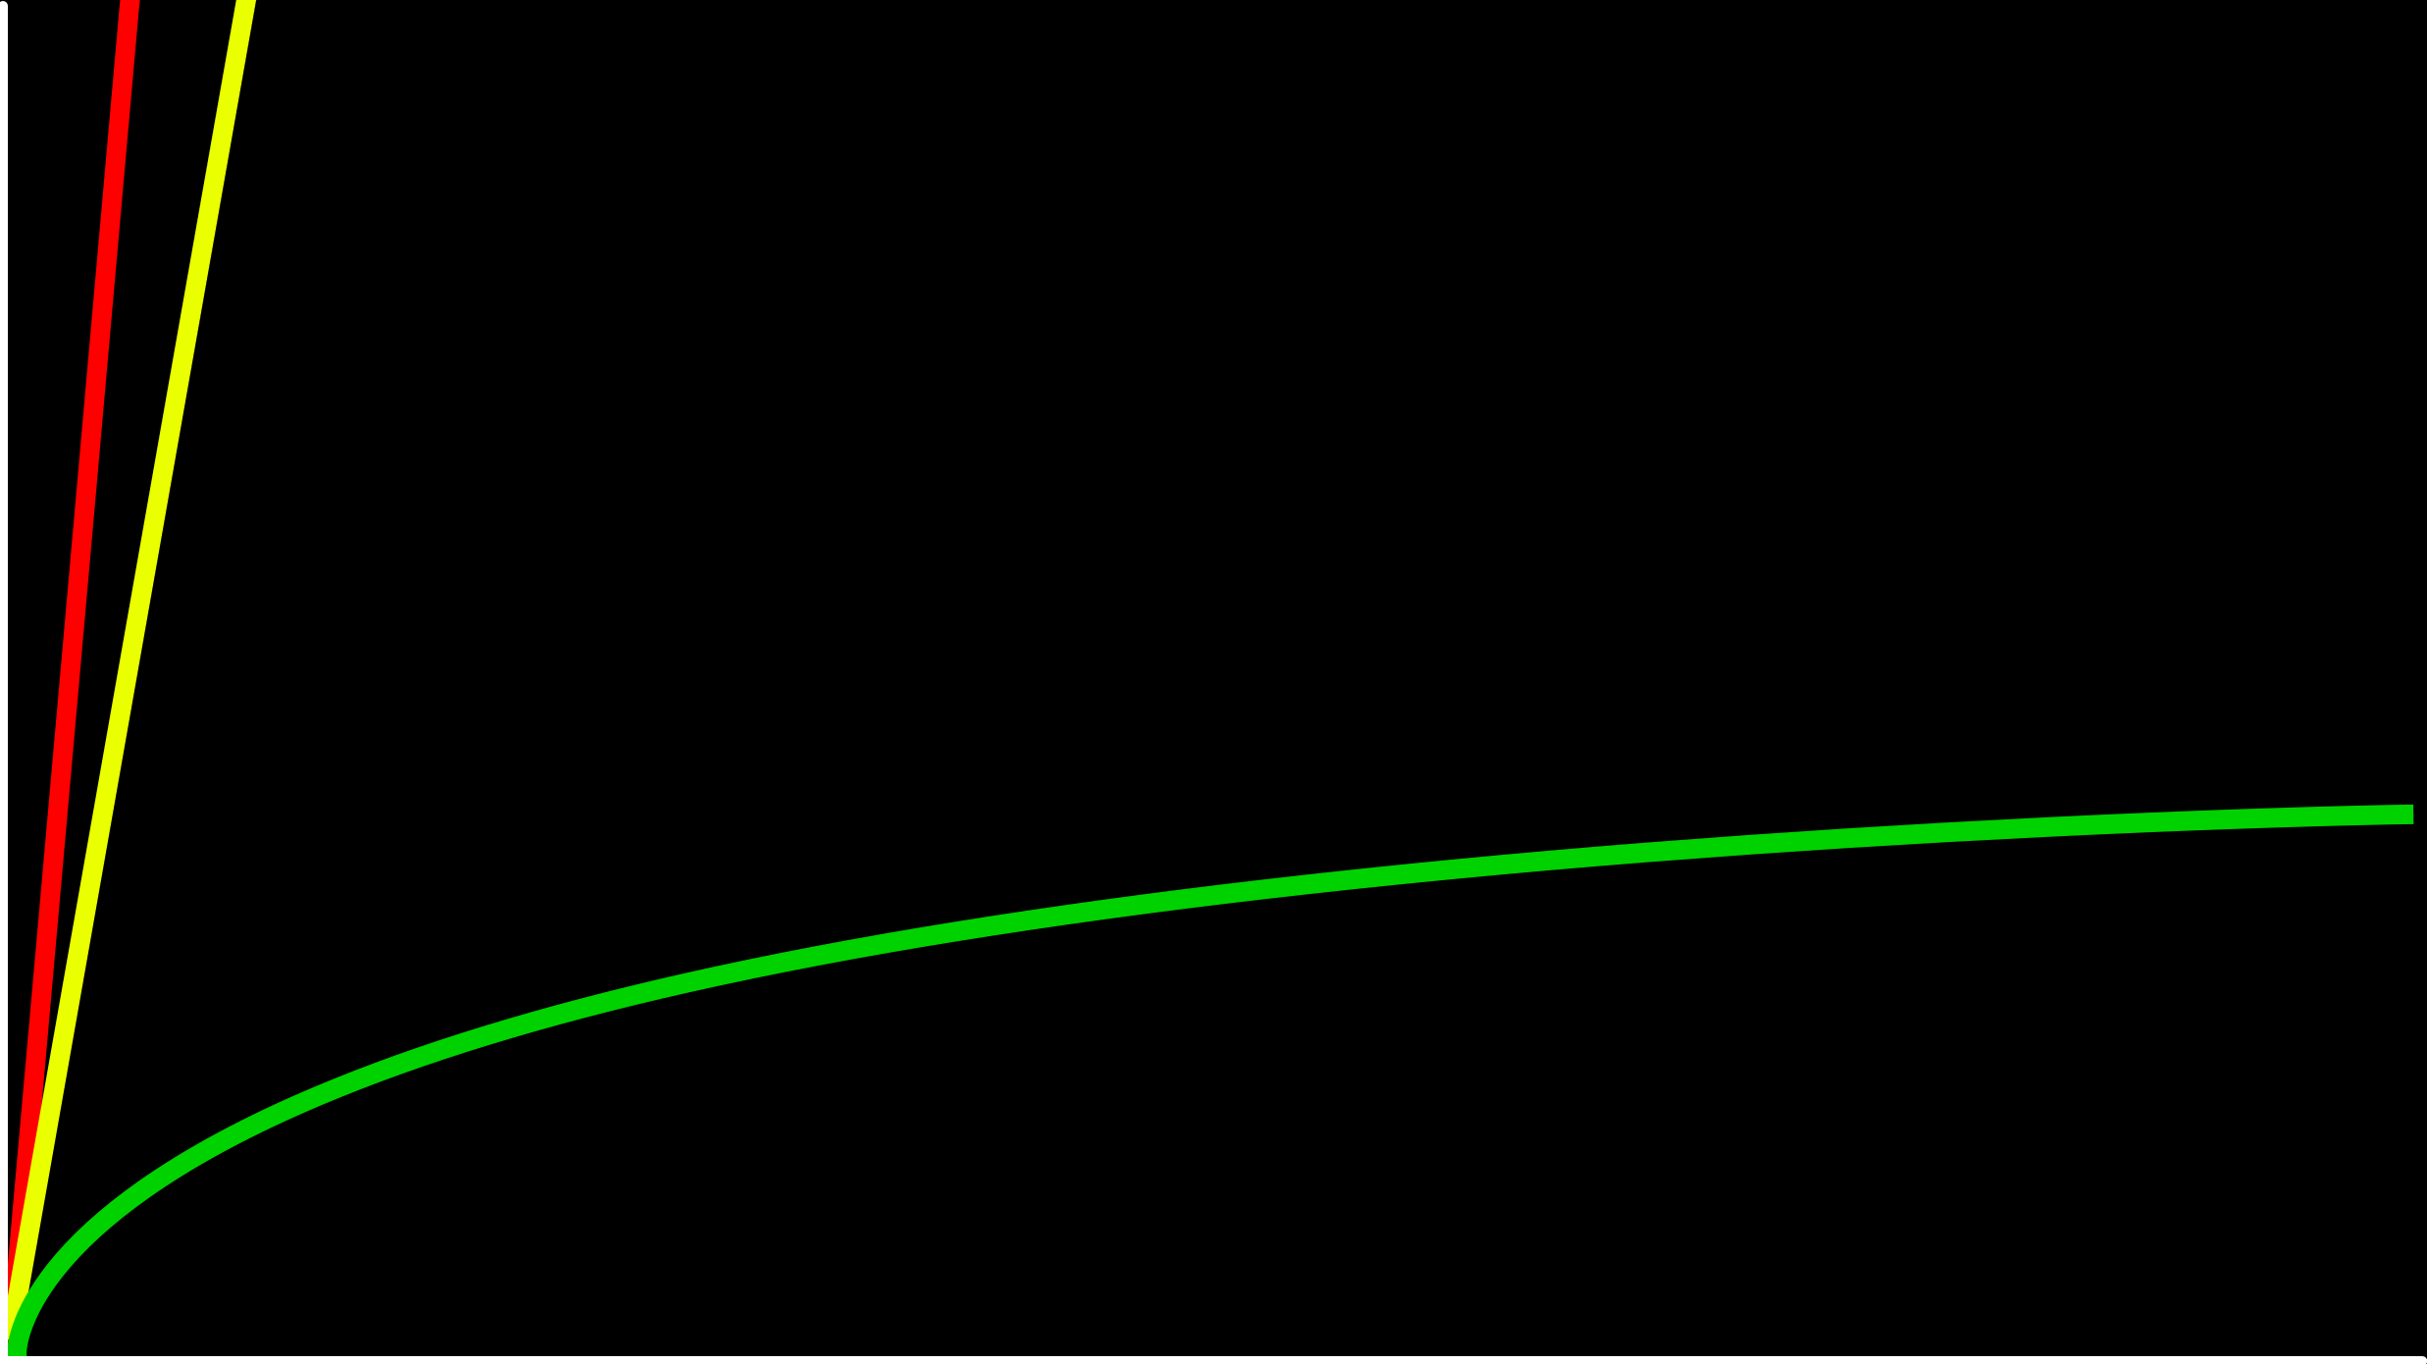
O(n)
time to solve
O(log n)
size of problem

Slide 151
O(n)
time to solve
O(log n)
O(1)
size of problem

Slide 152
hashing
Notes:
cards into buckets

Slide 153
hash function

Slide 154
hash tables

Slide 156
0
1
2
3
4
5
6
7
8
9
10
11
12
13
14
15
16
17
18
19
20
21
22
23
24
25

Slide 157
A
B
C
D
E
F
G
H
I
J
K
L
M
N
O
P
Q
R
S
T
U
V
W
X
Y
Z

Slide 159
Mario

Slide 160
Luigi
Mario

Slide 161
Luigi
Mario
Peach

Slide 162
Birdo
Daisy
Goomba
Isabelle
King Boo
Luigi
Mario
Peach
Rosalina
Shy Guy
Toad
Wario
Yoshi
Zelda

Slide 163
Birdo
Daisy
Goomba
Isabelle
King Boo
Luigi
Lakitu
Mario
Peach
Rosalina
Shy Guy
Toad
Wario
Yoshi
Zelda

Slide 164
Birdo
Daisy
Goomba
Isabelle
King Boo
Luigi
Lakitu
Link
Mario
Peach
Rosalina
Shy Guy
Toad
Wario
Yoshi
Zelda

Slide 165
Birdo
Bowser
Bowser Jr.
Daisy
Donkey Kong
Diddy Kong
Dry Bones
Goomba
Ganon
Isabelle
King Boo
K.K. Slider
Luigi
Lakitu
Link
Mario
Peach
Petey Piranha
Rosalina
Shy Guy
Spike
Toad
Toadette
Tom Nook
Wario
Waluigi
Yoshi
Zelda

Slide 166
O(n²)
O(n log n)
O(n)
O(log n)
O(1)

Slide 167
O(n²)
O(n log n)
O(n)
O(log n)
O(1)

Slide 168
typedef struct
{
char *name;
char *number;
} person;

Slide 169
typedef struct node
{
char *name; char *number;
struct node *next;
} node;

Slide 170
node *table[26];

Slide 171
input →
→ output

Slide 172
hash function

Slide 173
Mario →
→ 12

Slide 174
Luigi →
→ 11

Slide 175
Laa
Lab
Lac
Lad
Lae
Laf
Lag
Lah
Lai
Laj
Lak
...
Lim
Lin
Lio
...
Luh
Lui
Luj
Lakitu
Link
Luigi
Notes:
17,576 buckets

Slide 176
#include <ctype.h>
int hash(char *word)
{
return toupper(word[0]) - 'A';
}

Slide 177
#include <ctype.h>
int hash(const char *word)
{
return toupper(word[0]) - 'A';
}

Slide 178
#include <ctype.h>
unsigned int hash(const char *word)
{
return toupper(word[0]) - 'A';
}

Slide 179
O(n)

Slide 180
O(n/k)

Slide 181
O(n)

Slide 182
O(1)

Slide 183
tries

Slide 184
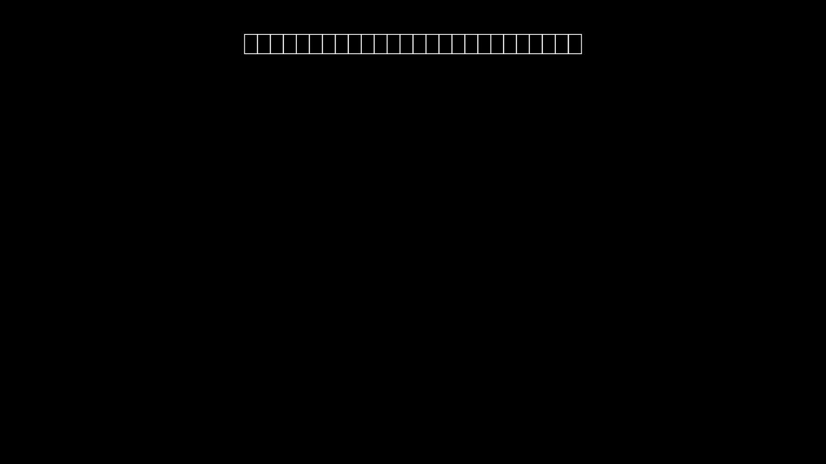

Slide 185
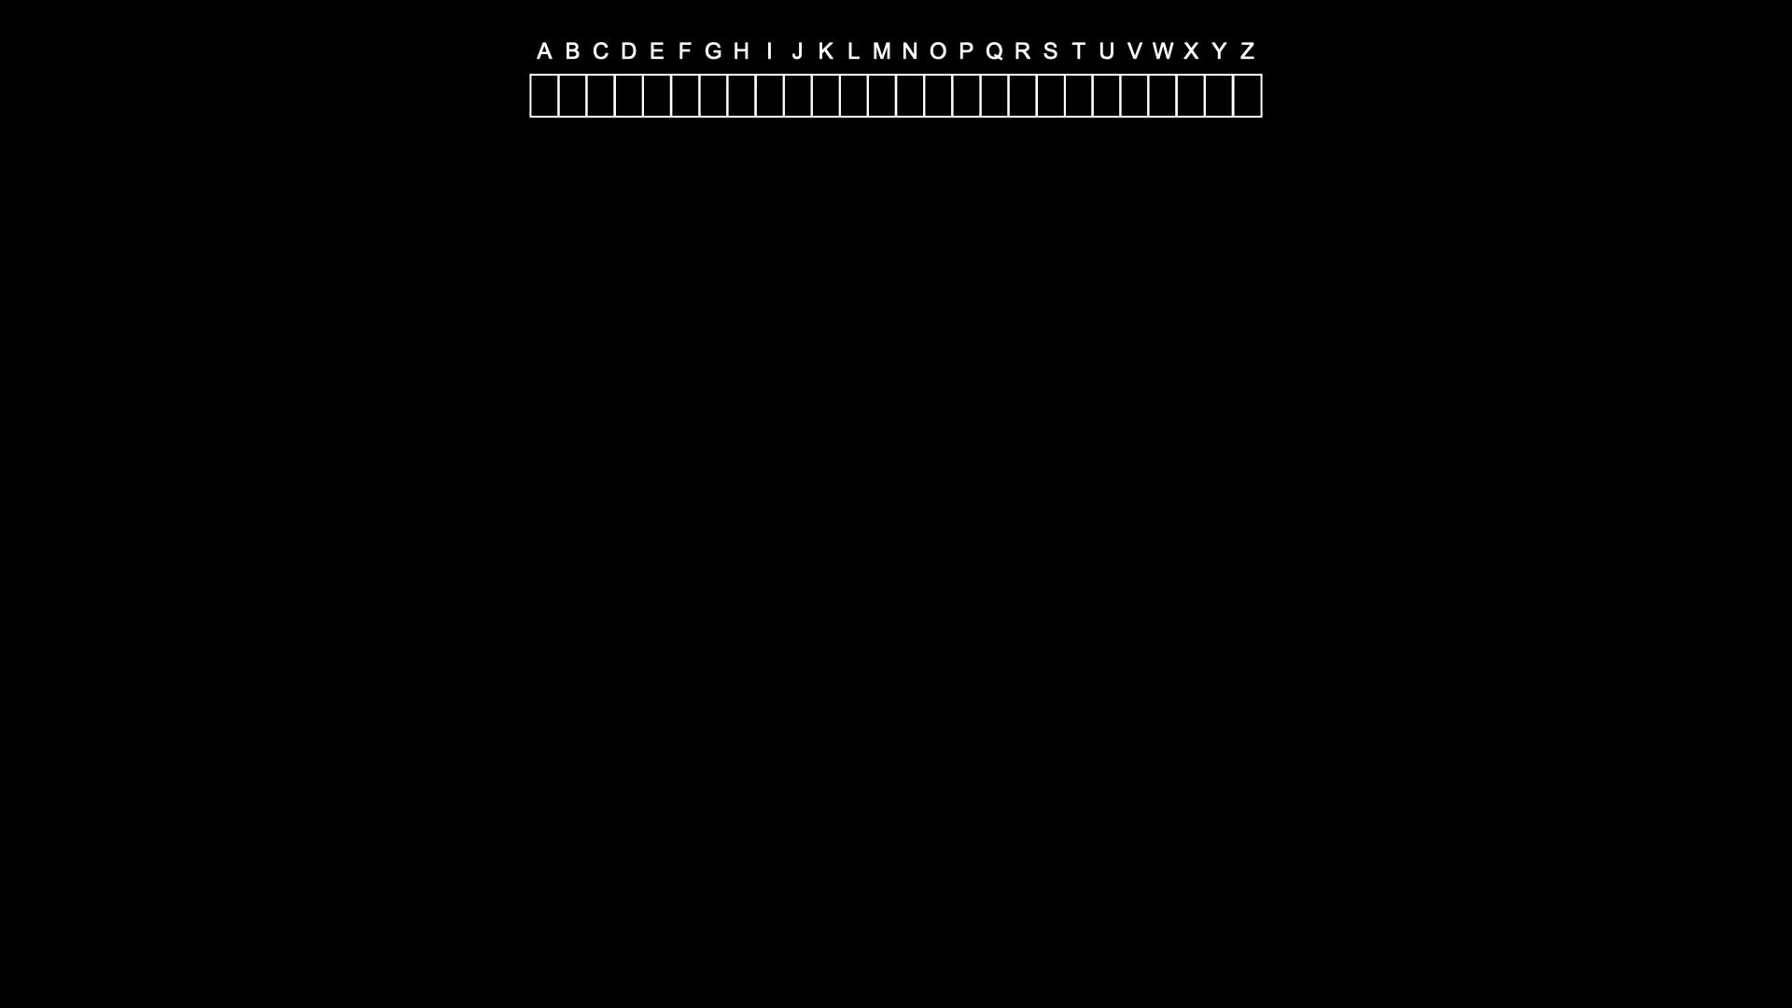

Slide 186
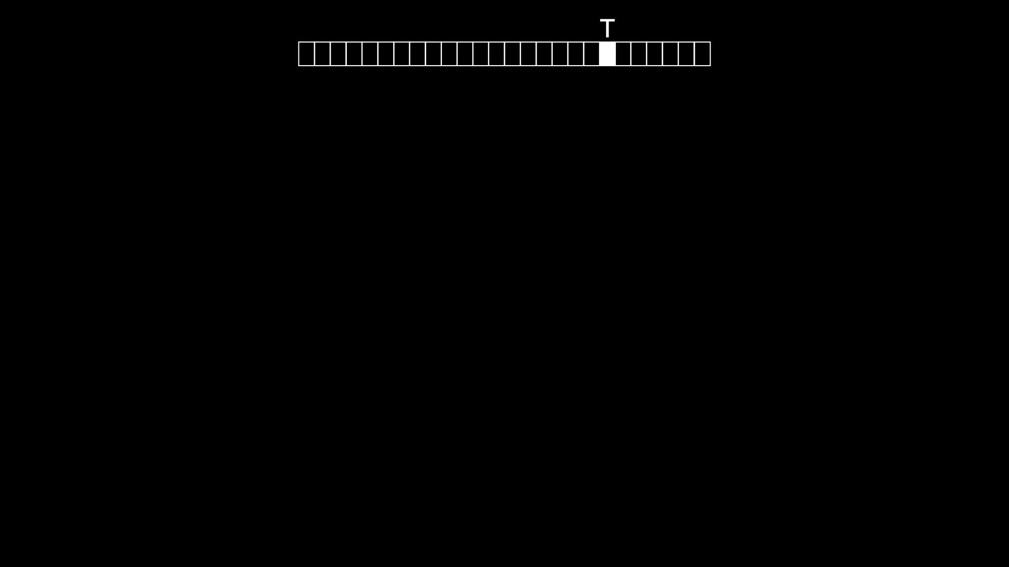

Slide 187
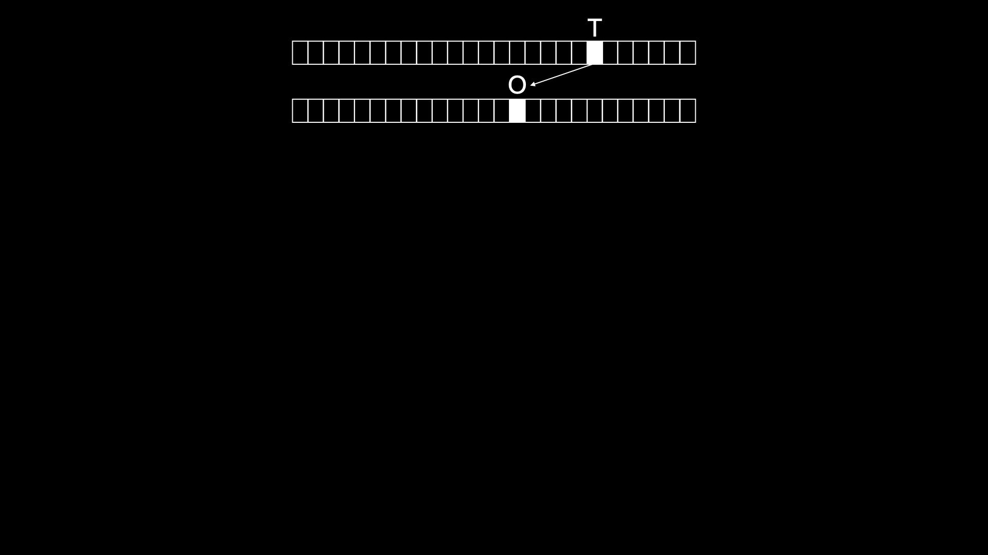

Slide 188
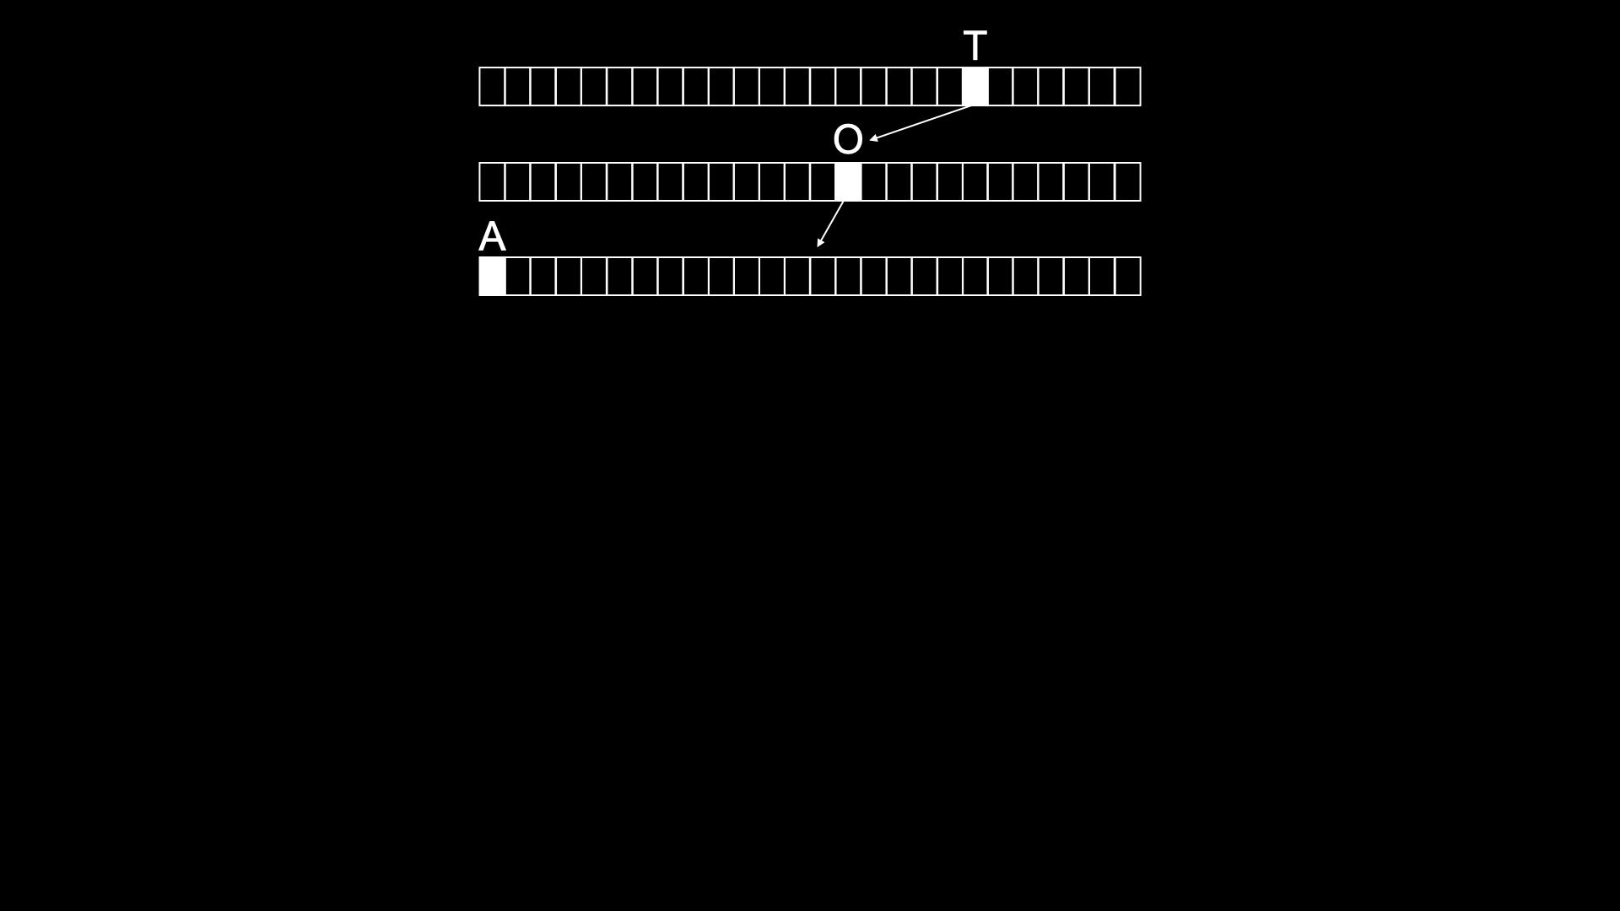

Slide 189
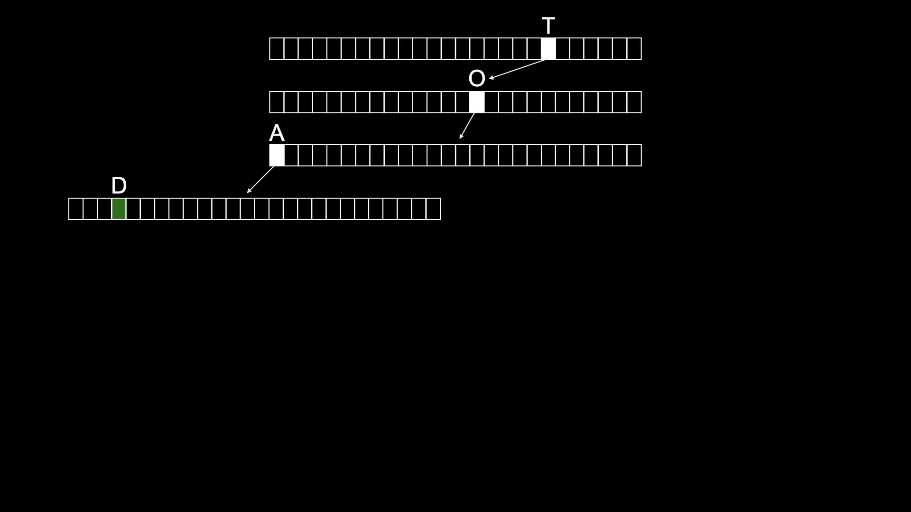

Slide 190
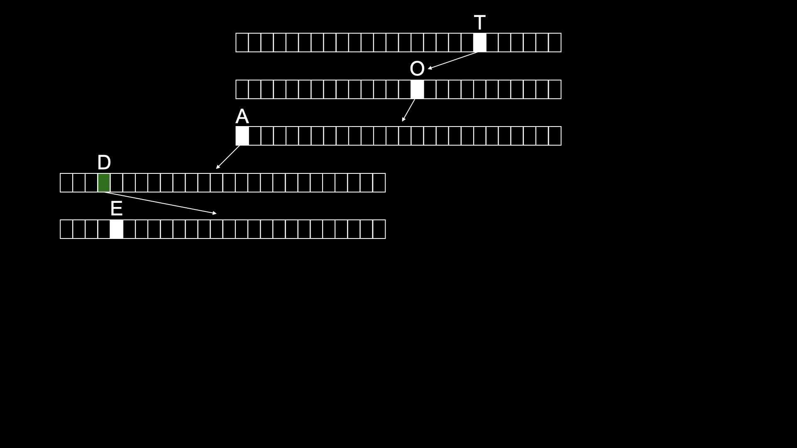

Slide 191
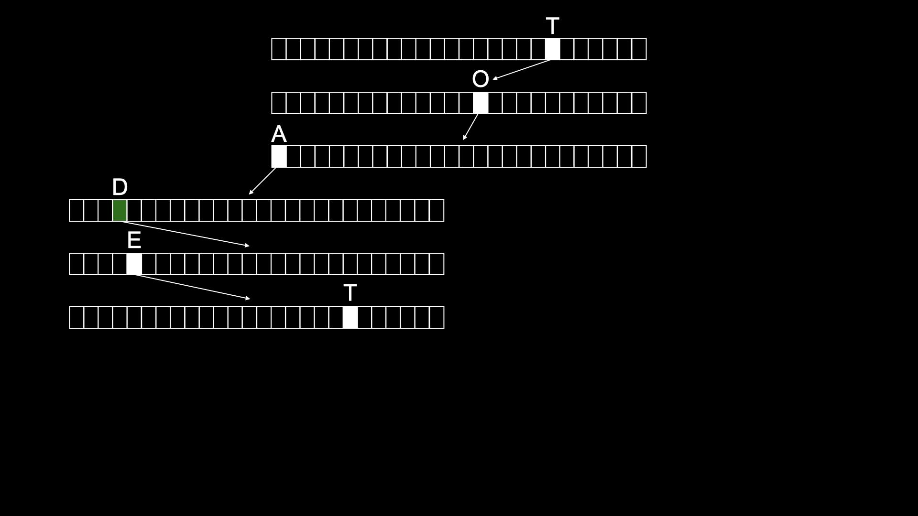

Slide 192
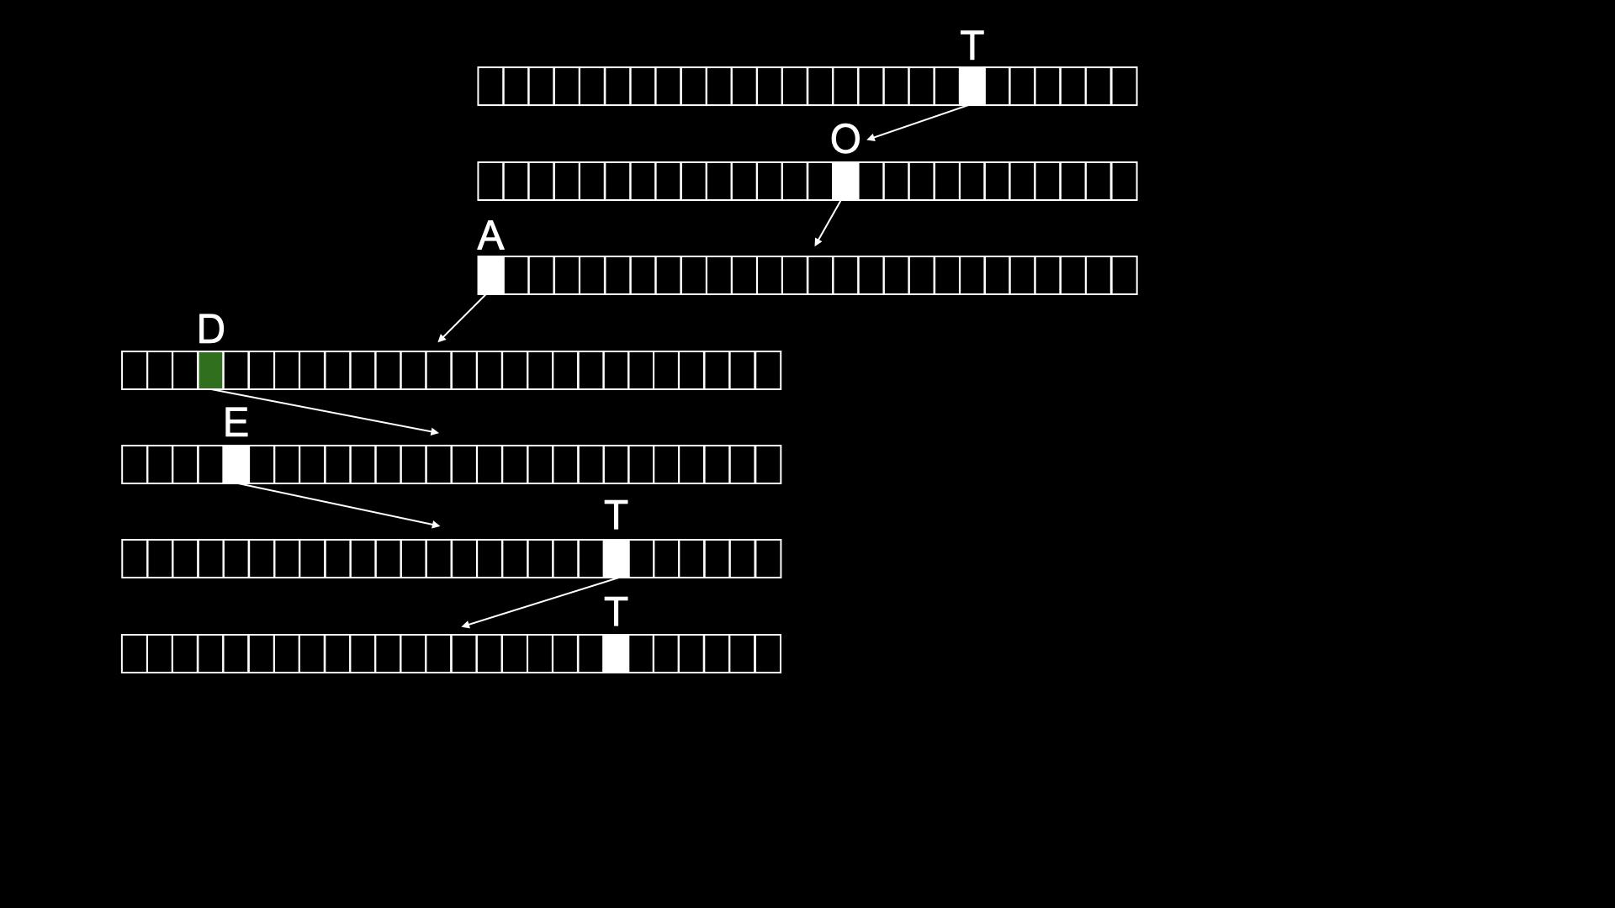

Slide 193
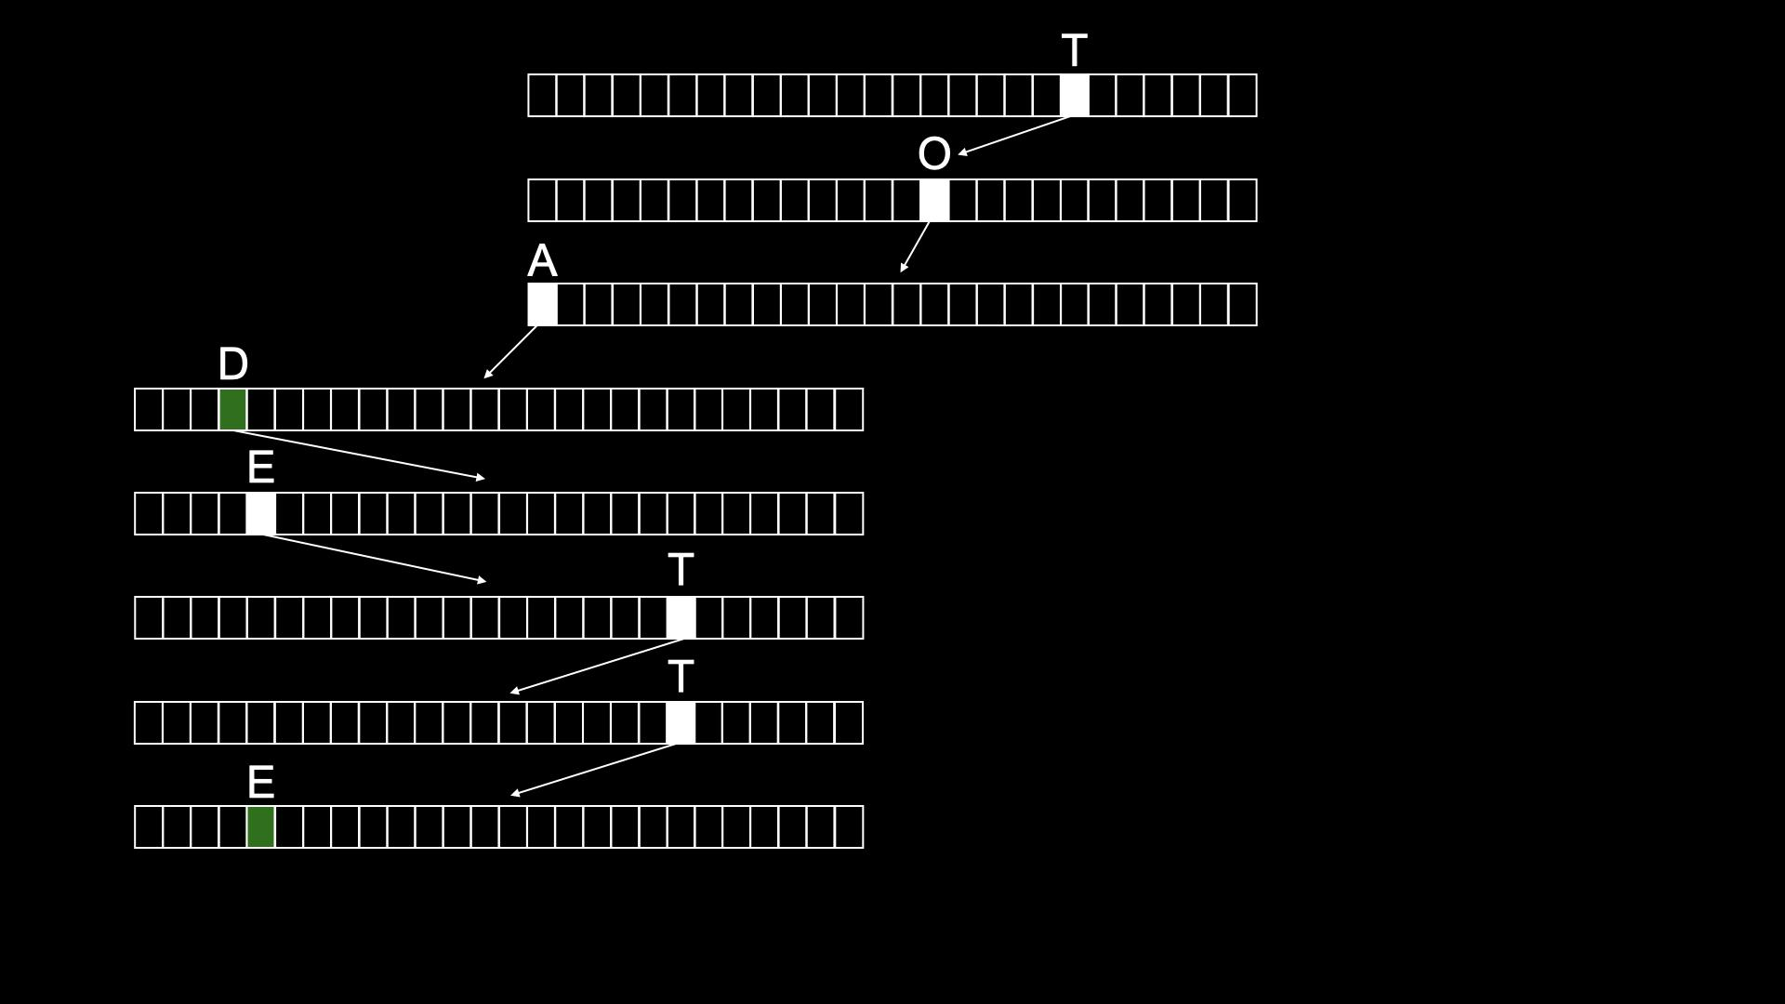

Slide 194
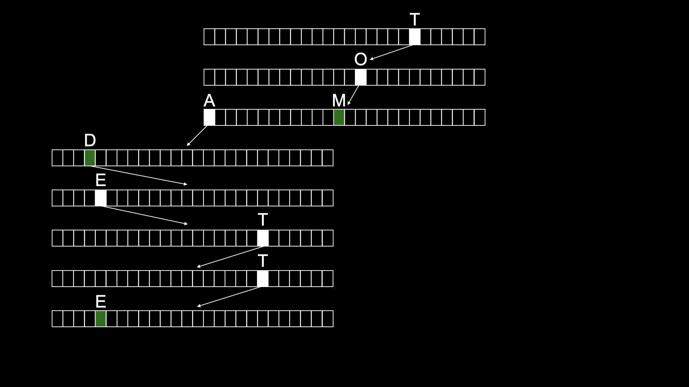

Slide 195
typedef struct node
{
struct node *children[26];
char *number;
} node;
Notes:
don't need to bother storing name, since implicit in trie

Slide 196
node *trie;

Slide 197
O(n²)
O(n log n)
O(n)
O(log n)
O(1)

Slide 198
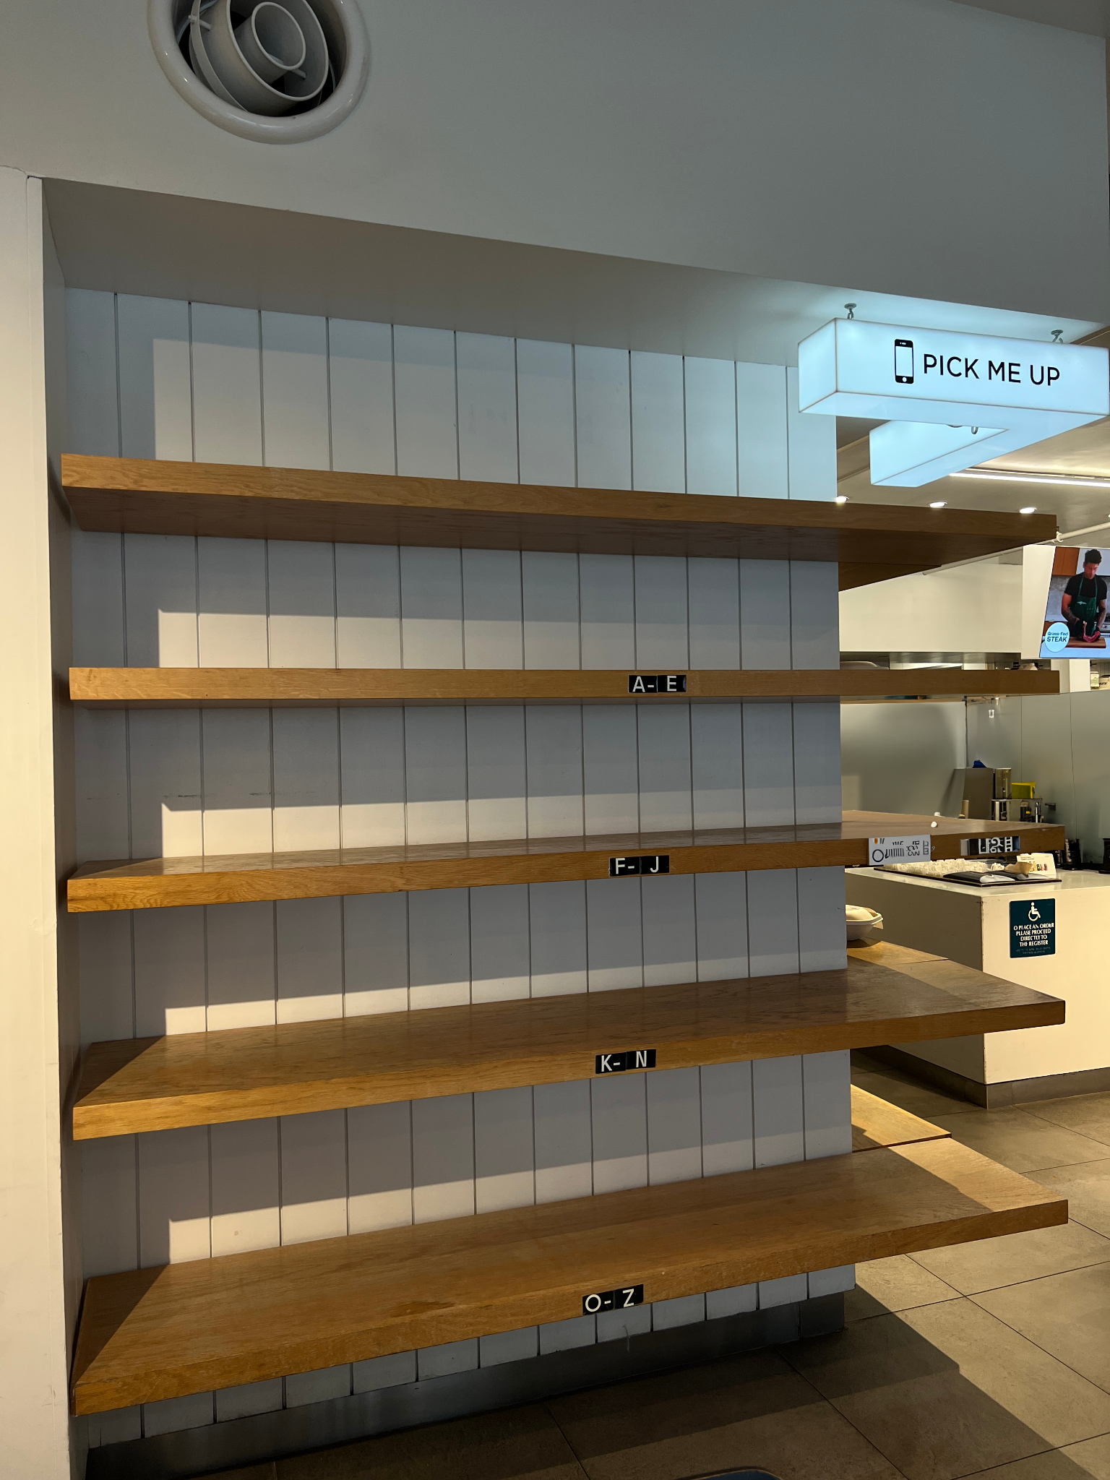

Slide 199


